Slide 1

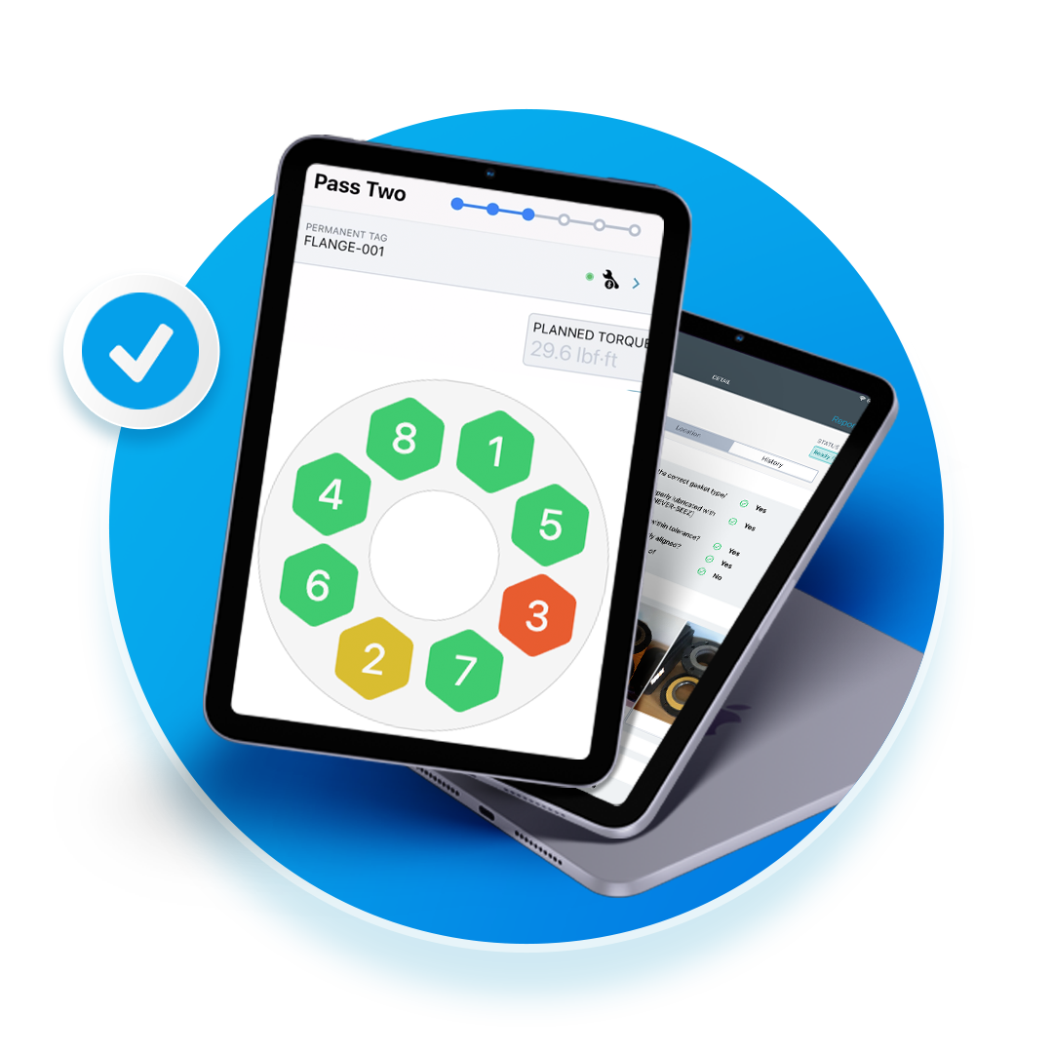

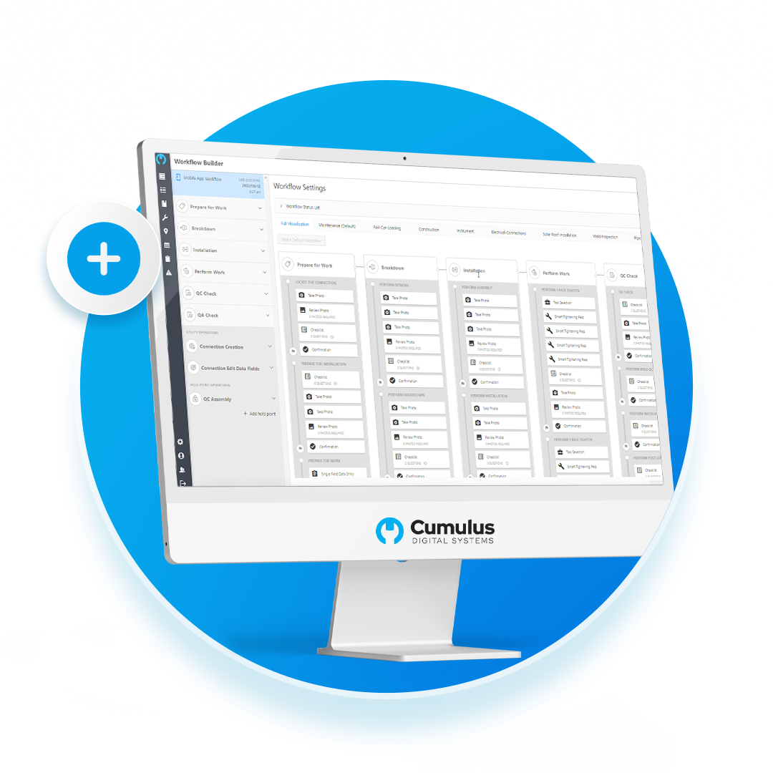
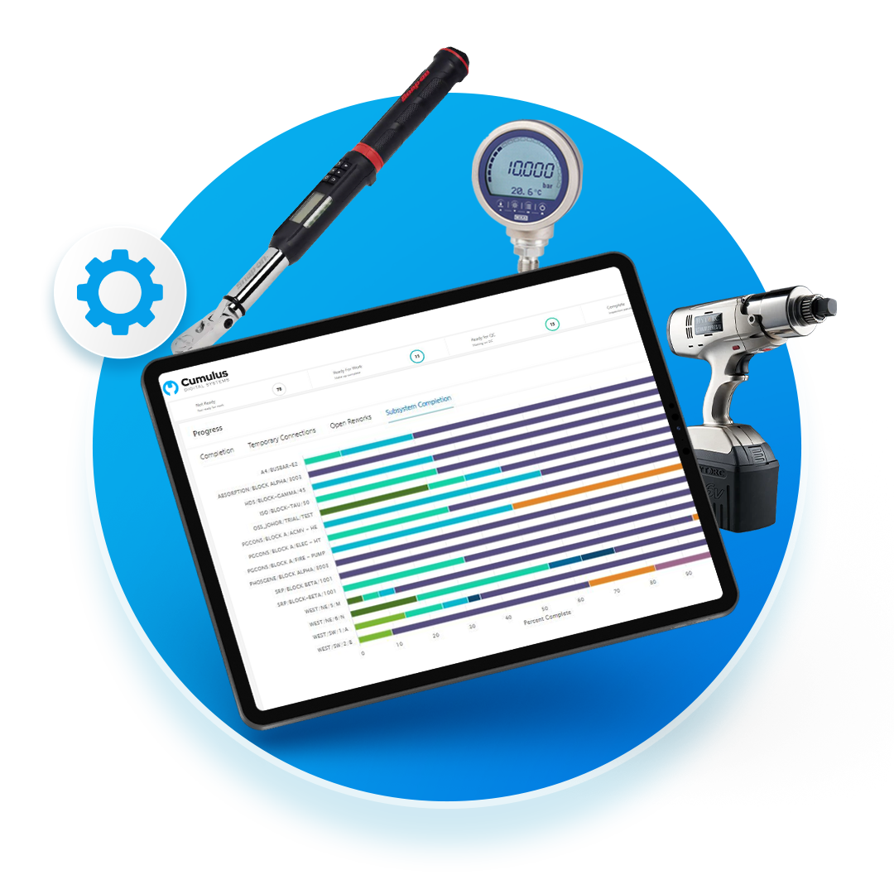
Candidate Exercise
Date

Slide 2


Agenda
01
02
03
A little About Me
Roughly 5 minutes to tell us about yourself and some context
Portfolio Accomplishment
Showcase one or two career highlights. Spend 5 mins on each
Presentation/Demo
Spend about 30 minutes walking through the demo with Q/A
Confidential | 2

Slide 3

Getting to Know You
I love coding!

Slide 4
Portfolio – Project Name
Problems
Bullet 1
Bullet 2
Bullet 3
Key takeaway
Results
Bullet 1
Bullet 2
Bullet 3
Confidential | 4

Slide 5
Portfolio – Project Name
Problems
Bullet 1
Bullet 2
Bullet 3
Key takeaway
Results
Bullet 1
Bullet 2
Bullet 3
Confidential | 5

Slide 6
Demo & Discussion

Slide 7
Describe your process and blockers
Give us a little insight into how you approached the problem, where you got tripped up or stuck, and how you resolved it.
Your text goes here
Your text goes here

Slide 8


Thank You!

Slide 9
Confidential | 9

Slide 10



Cumulus Values
RESPECT
Foster a respectful workplace that fuels open communication, creativity, and innovation by valuing and empowering our customers, partners, and employees.
CURIOSITY
Promote a culture of curiosity in all aspects of our work, encouraging an inquisitive approach towards our customers and solutions.
ADAPTABILITY
Be ready and accepting of change to maintain a competitive edge and stay ahead of competition.

Slide 11



Cumulus Values
SERVE OUR CUSTOMERS
Be Responsive. Act with Integrity. Be Useful. Value a bias toward action.
DO IT RIGHT, SAFELY
Provide best in class software and services to enable our customers to always get Work Done Right, meet and exceed all safety standards, and support our mission of eliminating global rework.
EVANGELIZE
Always promote our Work Done Right brand, solving problems for our customers.

